Slide 1

House Simple
“…this simple"
Khaled Al Najjar
Farukh Jabeen
Saad Moinuddin
Bhavnil Patel
Anna Sak
Chongli Zhao

Slide 2

What Is My Home Worth?
How do you determine the value of your home?
How much money is your home worth right now?
Should you sell your home now?
2
Notes:
Edit business

Slide 3
Approach
Collect data on home sales in Southern Ontario
City of Mississauga
Identify variables that affect home prices
Dependent:
Home price
Independents:
Rooms
Home style
Distance from points of interest
Model Data
OLS Algorithm
3

Slide 4
Methodology
Classification of properties according to their maintenance fees: Yes/No
Classification of properties according to the area: 34 areas
Adjusting the Sold Price to the inflation rate
Determination of minimum distance from the property to the Go-Stations and Hospitals using Geopy
Grouping the properties according to the season it was sold: Summer, Shoulder or Winter
Using a Linear Regression model to train the machine
Loading the train model into a Linear Regression to predict property values
4

Slide 5
Variables
DEPENDENT VARIABLE
Market Value
INDEPENDENT VARIABLES
Type of property (townhome, condo, detached)
Number of bedrooms and washrooms (estimators of sq ft)
Free hold
Geographical location
Distance to nearest Go Station and Major Hospital

Slide 6

HYPOTHESIS
“If a home is located within a closer vicinity of a Go Station and Hospital while also maintaining more desirable features, such as more rooms and washrooms, then we expect to see a higher market value for that home”

Slide 7
Analyzing The Data
Is there a relationship between key independent variables and the dependent variable?
Display visualizations of relationships between variables upon which hypothesis is based

Slide 8

8
Orderly Least Squares (OLS)
Model Formulation

Slide 9
Classification
9

Slide 10
Machine Learning
10
Split the data into Test and Train:
Fit the model with Data
Prediction

Slide 11
Results
11
Accuracy score and number of correct predictions
Evaluate model performance by calculating the residual sum of squares and variance score
Using Scatterplot to see the distribution of test and predicted values.
Plot a histogram of residuals to see if it’s normally distributed.

Slide 12
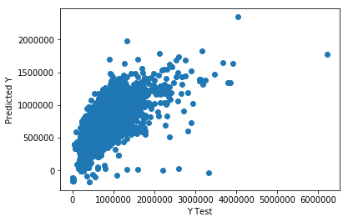
Visualization
Scatterplot
Y – Predicted Values
X – Test Values

Slide 13
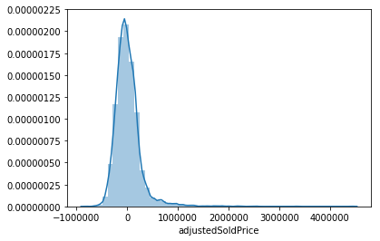
Visualization
Histogram
Residuals
X – Adjusted Sold Price

Slide 14

Further Development and Limitations:
Further Development
UI Development
Real time analytics
Length of time listed
Optimize model for each location
Implications of bank interest rate
Limitations
Square footage
Age of home
Upgrades and renovations

Slide 15

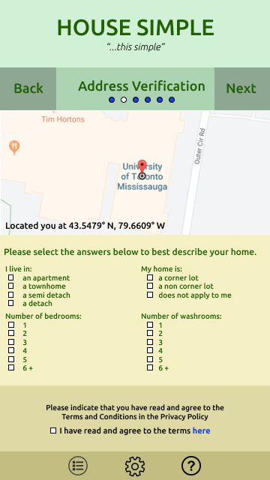
Concept and Production
Product and slogan are easy to remember
UI is user friendly and clutter free
Integration with Google Maps
Easily attainable data for categorical variables

Slide 16

Thank You!

